Slide 1
Project Architecture Document
Project: Client On Boarding
Presenter: Parthasarathy Thiyagarajan, Arunkumar Santhalingam
Date: Oct 19, 2010
PAD V2010 3.1

Slide 2
Agenda
Project Summary
Business Context
User Model and Key Use Cases
Architecture Diagrams
  Context
  Data Flow
  Deployment Environment
Component Reuse
Portal Integration
Security and Privacy
Disaster Recovery
Operation Resiliency and Controls
Operations
Monitoring
Availability, Performance & Capacity
PAD V2010 3.1
Page <number>

Slide 3
Project Summary
Purpose
To create an easy to use, flexible and integrated system for “client on boarding”
  Bring in customer information from internal or external systems
  Enter customer and account information via a flexible and simplified UI
  Fund the account
Benefits
Promotes asset consolidation program by eliminating a commonly sited obstacle – “it is too hard to open an account”
Promotes front-office initiation by providing multiple entry points and offers user friendly account opening experience to advisories
Reduces data entry by using existing data from Pershing and/or 3rd party applications, including CRMs
Enhanced field control offerings at Product / Company / Account
Address client on boarding - not just new account opening - by including additional account features/functions in on boarding process
  Supports account features such as Household, Selectlink, Margin, Options, Cash management, Relationship etc.
  Supports account funding options, such as a transfer or ACH (Standing and Periodic) instructions
  Eliminate time and clicks to enter new account information by providing a single screen for data entry
  Order of magnitude
  Phase 1: 9700 (4750 + 3750 (Config.) +1200 Including CRM integration)
PAD V2010 3.1
Page <number>

Slide 4
Project Team
Product Management
Lucille Mayer
Greg Kalosieh
Technology & Development
Tony Berman
Parthasarathy Thiyagarajan
Venkatesh Thalanki
Senthil Mayilsamy
Testing
Kevin Gallegar (QA)
Ramkumar Gajendramoorthy(QA)
Christine Jimenez (Business Testers)
Elizabeth Bowman(Business Testers)
Project Management / Business Analysis
Jason Betz
Arunkumar Santhalingam
SMEs
Michael Nesspor
David Crow
Nancy Newcome
Dolores Ratajczak
Michael Olofson
Evan LaHuta
PAD V2010 3.1
Page <number>

Slide 5
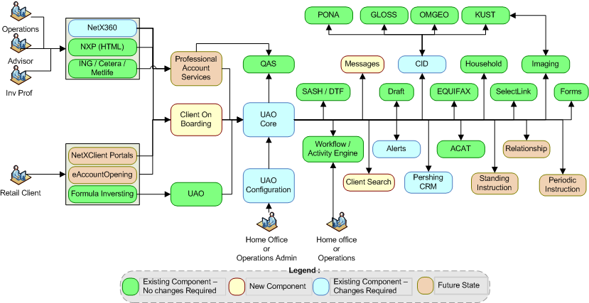
Business Context
PAD V2010 3.1
Page <number>

Slide 6
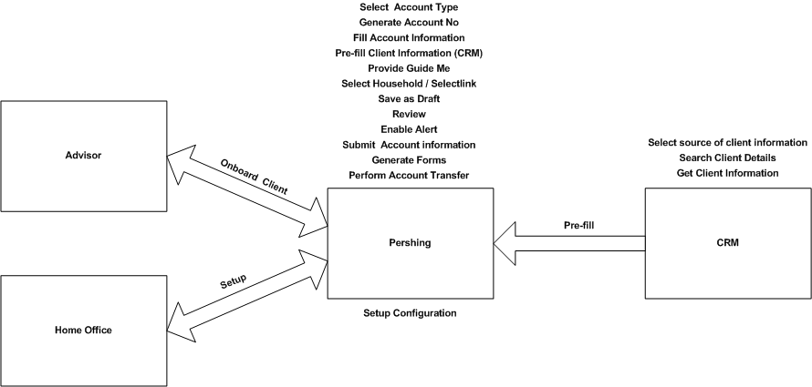
User Model
PAD V2010 3.1
Page <number>

Slide 7
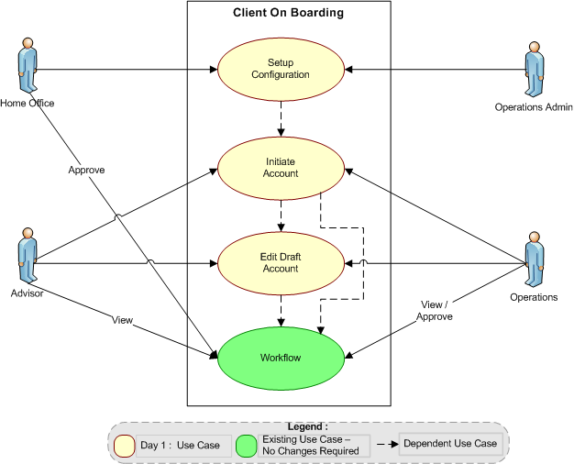
Use Case
PAD V2010 3.1
Page <number>

Slide 8
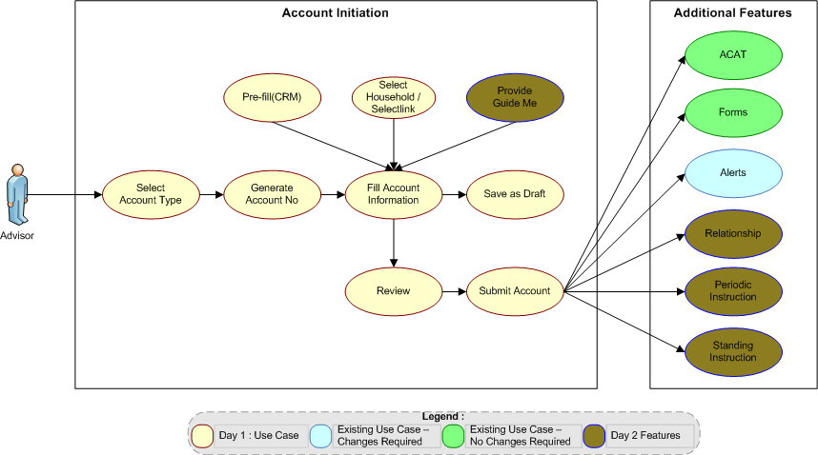
Detail Use Case
PAD V2010 3.1
Page <number>

Slide 9
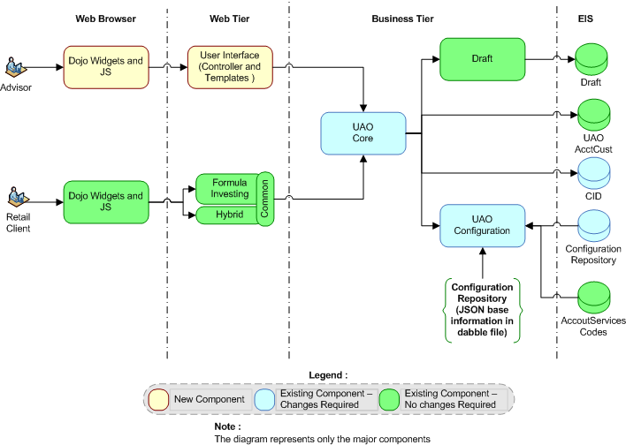
Architecture Diagram – Context
Account Opening
PAD V2010 3.1
Page <number>

Slide 10
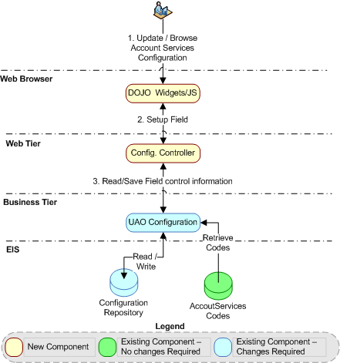
Architecture Diagram – Data Flow
Setup Configuration
PAD V2010 3.1
Page <number>

Slide 11
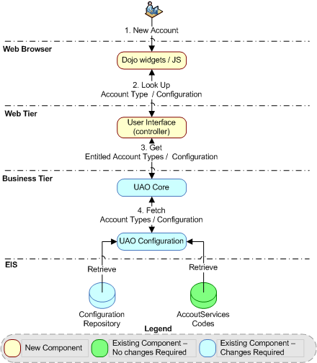
Architecture Diagram – Data Flow (Cont.)
Select Account Type / Read Configuration
PAD V2010 3.1
Page <number>

Slide 12
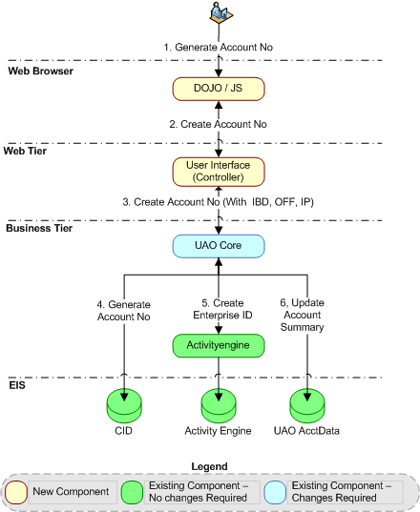
Architecture Diagram – Data Flow (Cont.)
Generate Account No
PAD V2010 3.1
Page <number>

Slide 13
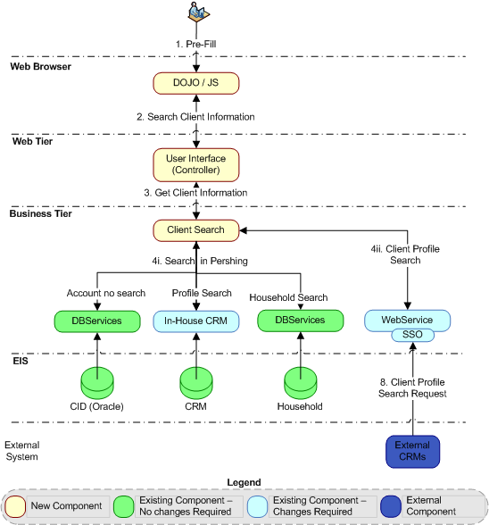
Architecture Diagram – Data Flow (Cont.)
Pre-fill (Client Search)
PAD V2010 3.1
Page <number>

Slide 14
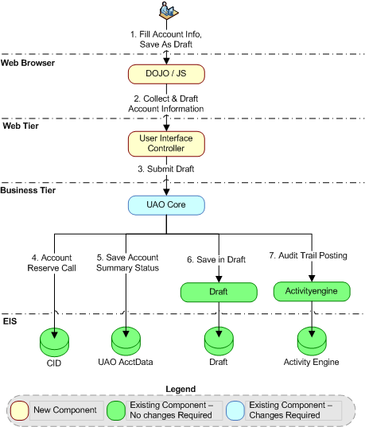
Architecture Diagram – Data Flow (Cont.)
Fill Account Info / Save As Draft
PAD V2010 3.1
Page <number>

Slide 15
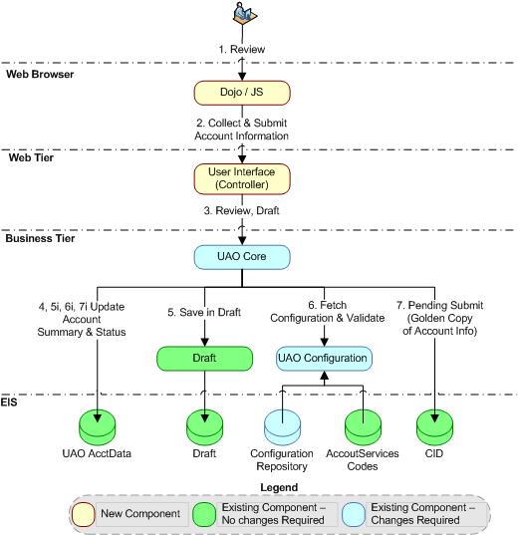
Architecture Diagram – Data Flow (Cont.)
Review
PAD V2010 3.1
Page <number>

Slide 16
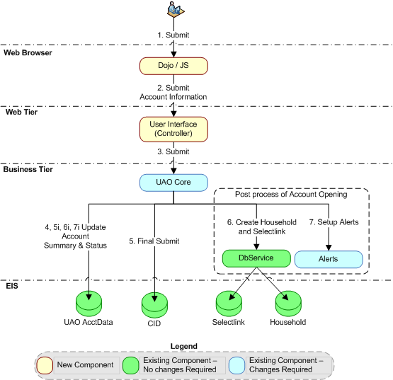
Architecture Diagram – Data Flow (Cont.)
Submit Account
PAD V2010 3.1
Page <number>

Slide 17
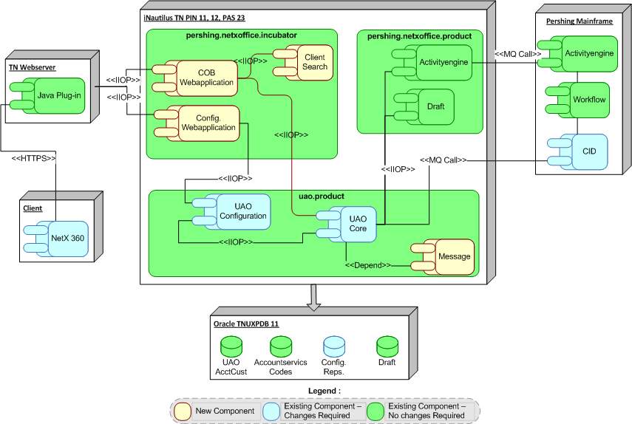
Architecture Diagram – Deployment Environment
PAD V2010 3.1
Page <number>

Slide 18
Architecture Diagram – Deployment Environment (Cont.)
FP would have the same setup in Webserver and iNautilus Application Server (PIN 11, 12, PAS 23).
FP Domain - Read connections will point to FP Database server. write connections will point to TN Database server
Database Setup
  Primary server : TNUXPDB11
  Failover server : FPUXPDB11
PAD V2010 3.1
Page <number>

Slide 19
Common Service - Reuse
Common Service Name | Commonly Known As | Type of Re-use (New / Reused / Enhanced) | Common Service Reference | Reuse Points | Notes | Doc Due Date
Client Data (Golden Copy) | CID | Enhanced | DT1-CLT | Repository which holds customer Information | Changes are very limited
Client On Boarding Web Component | Account Opening | New |  | User Interface for Client on boarding.
AccountOpeningService | Account Opening | Enhanced |  | Account Services to CID Integration layer
UAORequestManager | Account Opening | Enhanced |  | AccountServices system integrator
UAOConfigService | Account services field configuration | Enhanced |  | Centralized configuration for field control and branding
UAOBatchService | Account Service Online Batch Process | Enhanced |  | Online batch process to support additional feature(ex: Household, Selecttlink, etc.)
Search Client Information | CRM(Internal and External) | New |  | Fetching Client Information from CRM.
Draft Service | Draft | Reused |  | Persistence of draft information, before submit to CID.
Workflow and Activity Engine | ActivityEngine service, workflow | Reused |  | Workflow process management and Audit Trail
PAD V2010 3.1
Page <number>

Slide 20
Common Service – Reuse (Cont.)
Common Service Name | Commonly Known As | Type of Re-use (New / Reused / Enhanced) | Common Service Reference | Reuse Points | Notes | Doc Due Date
DBServices | Household, Selectlink and eDelivery | Reused |  | Logical grouping of account based on a business need. Subscriber id create for client site.
PDF form Generation | Forms | Reused |  | Generate pre-printed forms with customer information.
Alerts | Alerts | New |  | Transaction level real-time notification that a subscribed to event(s) have occurred.
AddressVerifyService | QAS | Reused |  | To verify and validate the user entered address.
DocumentManagementServicesBean | Imaging | Reused |  | Copying good order document s.
User Authentication | DASF (NPNX/ASDS) | Reused |  | To provide application level security .
GatewayService | Middleware | Reused |  | Communication between disparate processes
PAD V2010 3.1
Page <number>

Slide 21
Component – Reuse
Component Name | New- Reused- Enhanced | Notes | Reference (If available)
Generic lookup pop-up For CRM Search | New
NetX Studio | Reused
DOJO (1.4.3.2) | Reused
iNautilus Framework | Reused
UAO Core | Enhanced
UAO Config | Enhanced
PAD V2010 3.1
Page <number>

Slide 22
Portal Integration
NetX360
  “Account “Tab in Top navigation
  Right click on accounts within Household in left navigation
  Right click on accounts within Selectlink in left navigation
TOPIC | LIST APPROVED SOLUTION PATTERN | EXCEPTION or ISSUES
Technology Stack | PCFN, Web Studio (JSF/DOJO) and iNautilis
Navigation | Pop-ups, Back Button, Session State
Session Management | SSO, Sub-session
Cross Portal Support | 360, 360.com
Customization | iNautilus Service (Client On Boarding)
PAD V2010 3.1
Page <number>

Slide 23
Security and Privacy
Item | Used? | Comments
DASF | Yes | Existing Authentication is used.
Top Secret | Yes | Existing setup is used.
NPNX ASDS EMS | Yes | Existing ASDS entitlements and new NPNX has been introduced to view the launch points in NetX 360.
SSO | Yes | During Login in Netx360
Encryption | Yes | Follows the existing encryption methods.
High Confidential Data | Yes | Existing entitlement used for SSN.
Active Directory | No
SiteMinder / xID | No
LDAS (Notes) | No
PAD V2010 3.1
Page <number>

Slide 24
Disaster Recovery
Backup / Recovery
  Follows the existing Oracle and DB2 backup/recovery procedures
  Follows the existing ecommerce application backup/recovery procedures
Business Continuity
  A failure on the Oracle will follow existing B/C process
  Follows the existing BC process used for ecommerce applications
PAD V2010 3.1
Page <number>

Slide 25
Operation Resiliency and Controls
Local Failover processes
  Distributed – No new change introduced by this project.
  No special handles for bank holidays
PAD V2010 3.1
Page <number>

Slide 26
Operations
OPERATIONS FUNCTION | ACTIVITY | WHO WILL PERFORM
How installed and configured | Standard move procedures | DSCM,SCM
How started | Standard startup procedures | SCM
How reset | Standard reset procedures | SCM
How upgraded | Standard upgrades | SCM
How maintained | Standard move procedures | SCM, DBA
How monitored | Standard monitoring procedures | OSS
PAD V2010 3.1
Page <number>

Slide 27
Capacity, Availability & Performance (CAP)
Front-End will be available 23 ½ x 7 ( Regular bounce 1/2 hours)
Back-End availability
  CID – 1 EST to 20 EST and 21 EST to 23.45 EST
  SASH – 1 EST to 20 EST and 23 EST to 23.59 EST
  Performance should be the same as or better than the current standard for all iNautilus application that is 97% less than 1 second
PAD V2010 3.1
Page <number>

Slide 28
Appendix
UI Specifications Document
http://wiki.pershing.com/confluence/download/attachments/939098196/ClientOnboarding_UISpecs_092010.doc
CRM Integration
  http://wiki.bankofny.com/confluence/download/attachments/962887784/ClientOnBoard+CRM+Integration.doc
PAD V2010 3.1
Page <number>

